Slide 1
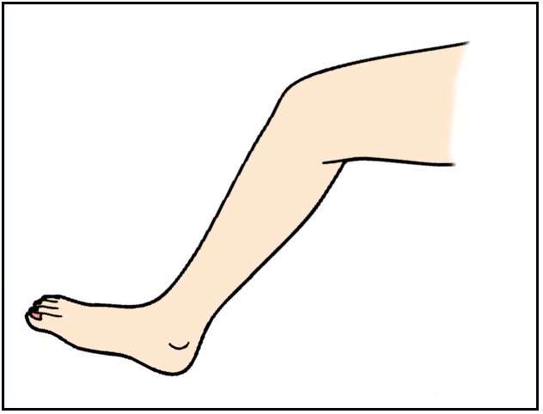
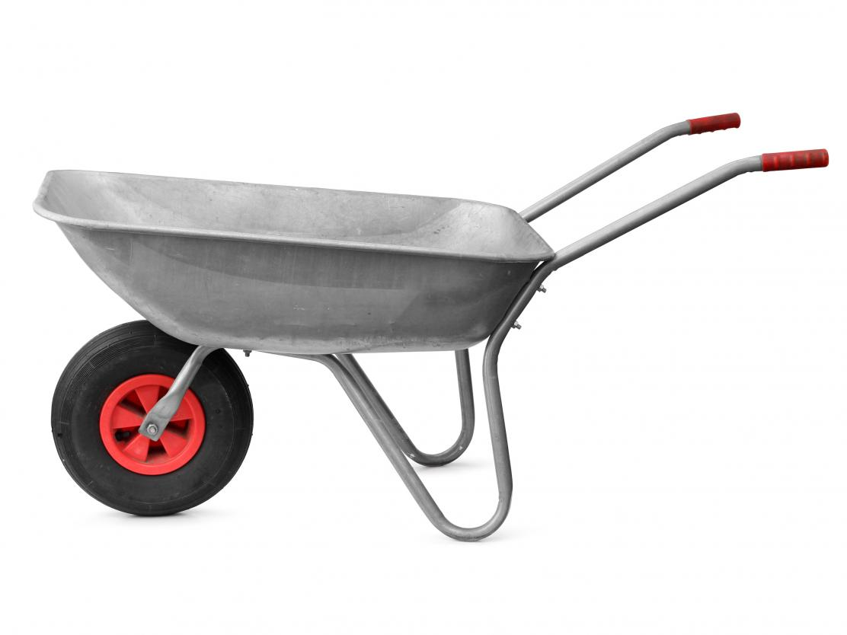
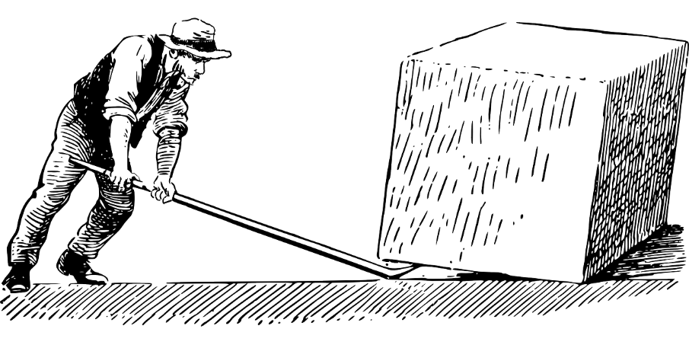
Daily Review
A lever is a solid rod or bar that is supported at a turning point called a fulcrum.
For each of the following levers, label the fulcrum.
Vocabulary
lever (noun) a solid rod or bar supported at a turning point fulcrum (noun) the turning point of a lever
Notes:
45 s → share → popsticks

Slide 2
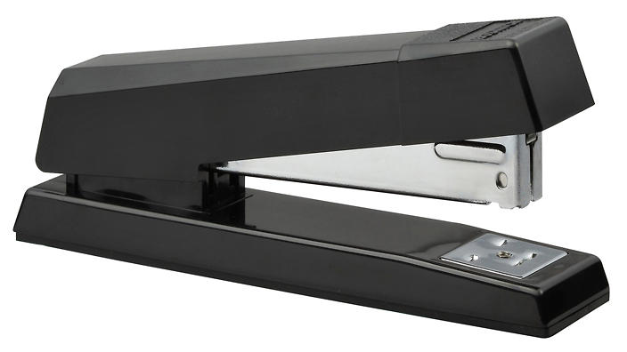
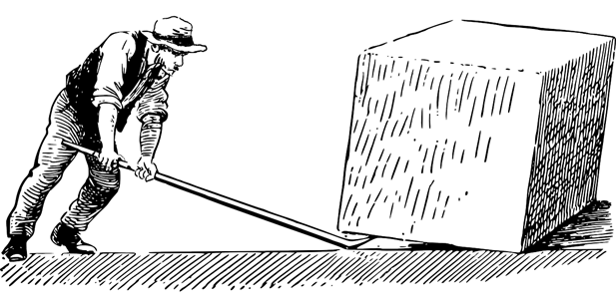
Daily Review
You apply an input force to a lever to create an output force.
For each of the following levers, label the input and output forces.
Vocabulary
output force (noun) the force that a lever creates input force (noun) the force used to operate a lever
Notes:
45 s → share → popsticks

Slide 3
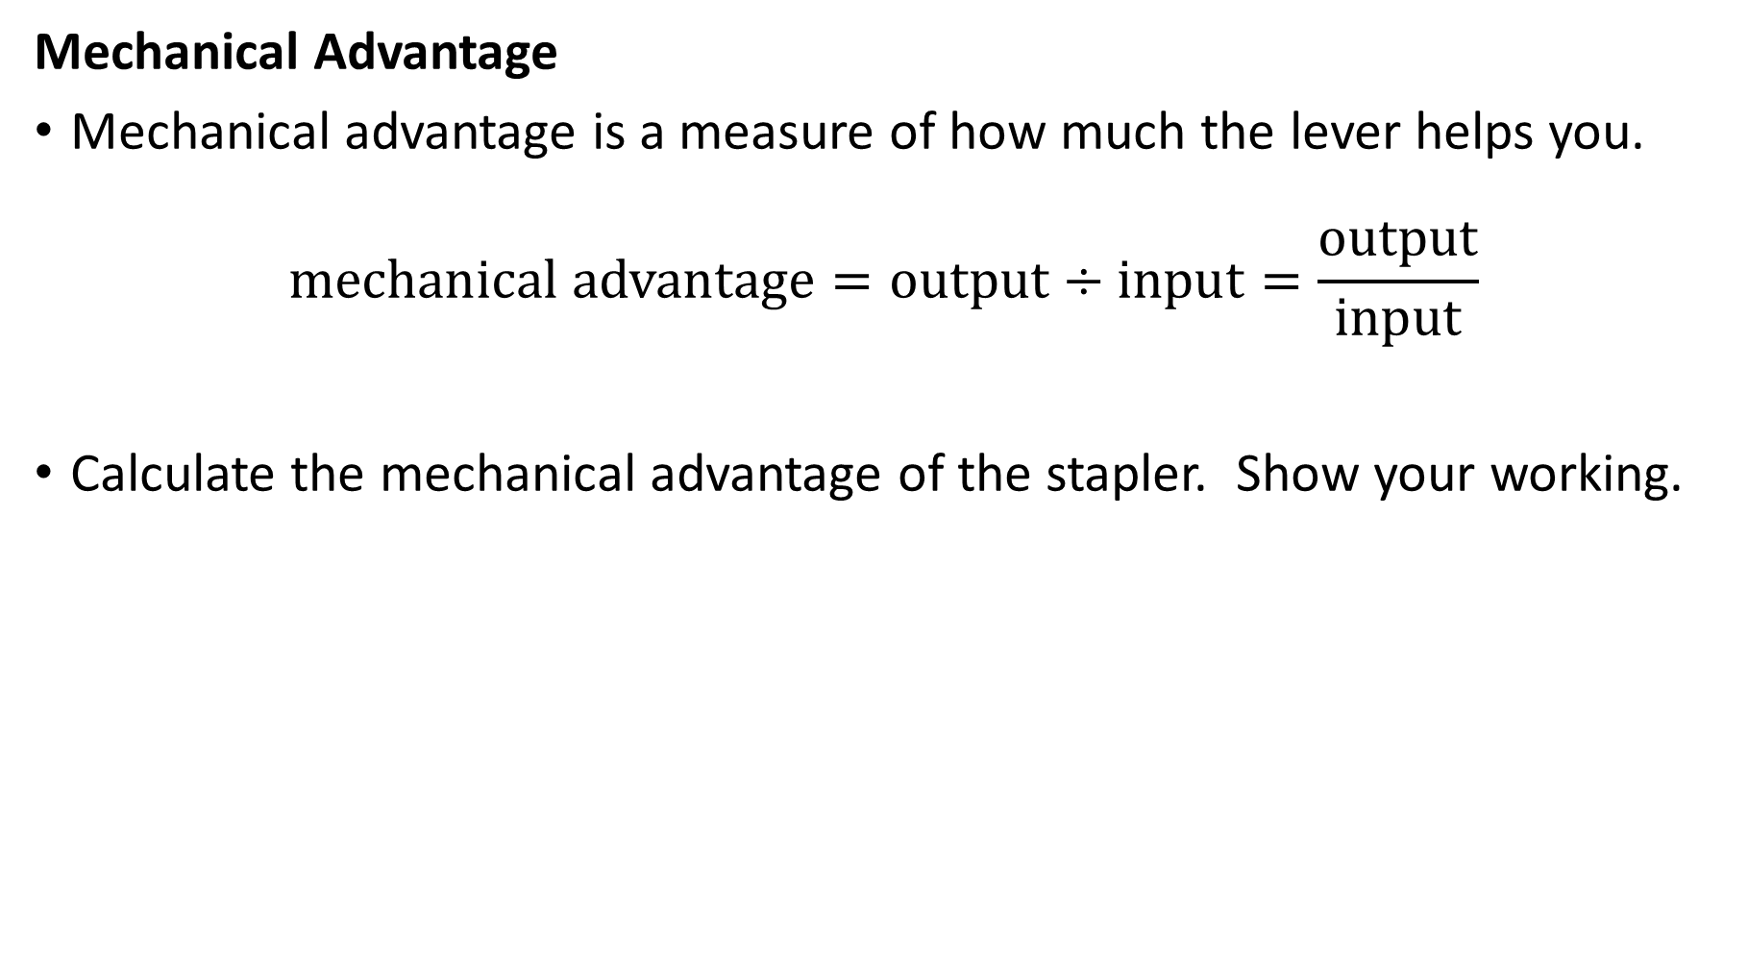
Daily Review
Mechanical Advantage
Mechanical advantage is a measure of how much the lever helps you.
$$\text{mechanical} \text{advantage}=\text{output}÷\text{input}=\frac{\text{output}}{\text{input}}$$
Calculate the mechanical advantage of the stapler. Show your working.
Output force (50 N)
input force (5 N)

Slide 4
Simple Machines: Types of Levers Year 7 Science

Slide 5
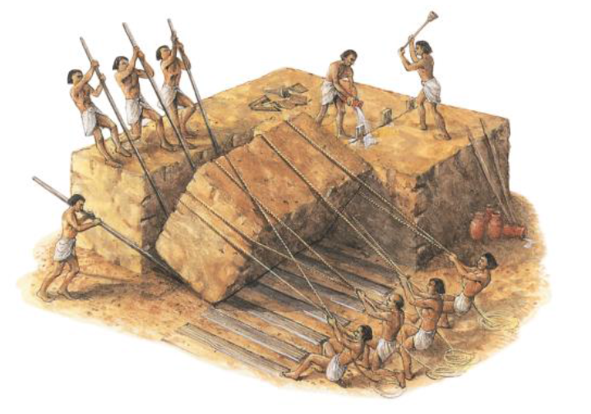
Learning Objectives
Describe and identify the three different classes (types) of lever.
CFU
How many classes of lever are there?
Activate Prior Knowledge
Levers are just one type of simple machine that has been around for thousands of years.
Think, Pair, Share:
Where else can are levers used to make everyday tasks easier?

Slide 6
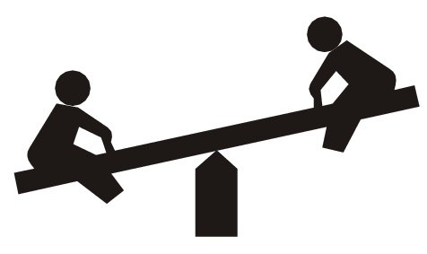
Concept Development
CFU 1
Label the fulcrum, input force, and output force on the seesaw.
Classes of Levers
Before you can work out a lever’s class (type) you need to find the fulcrum, the input force, and the output force.
The class of the lever depends on which one is in the middle.
CFU 2
What does the class of lever depend on?
CFU 3
In the seesaw example, what is in the middle?
fulcrum (turning point)
output force
input force

Slide 7
Concept Development
CFU 1
Where is the fulcrum positioned in class 1 levers?
Class 1 Levers
Also known as first-class or type 1 levers, class 1 levers have the fulcrum in the middle.
CFU 2
What are class 1 levers also called?
input force
output force
CFU 3
Think, Pair, Share: Where else have you seen a class 1 lever?
Vocabulary
fulcrum (noun) the turning point of a lever
fulcrum (turning point)

Slide 8
Concept Development
CFU 2
What is in the middle of a class 2 lever?
Class 2 Levers
Also known as second-class or type 2 levers, class 2 levers have the output force in the middle.
CFU 1
What is another name for a class 2 lever?
CFU 3
Think, Pair, Share: What is another lever that has the output force in the middle?
input force
output force
Vocabulary
output force (noun) the force that a lever creates
fulcrum (turning point)

Slide 9
Concept Development
CFU 1
What is in the middle of class 3 levers? fulcrum input force output force none of the above
Class 3 Levers
Also known as third-class or type 3 levers, class 3 levers have the input force in the middle.
output force
input force
CFU 2
What are class 3 levers also known as?
CFU 3
Think, Pair, Share: Name another class 3 lever.
fulcrum (turning point)
Vocabulary
input force (noun) the force used to operate a lever

Slide 10
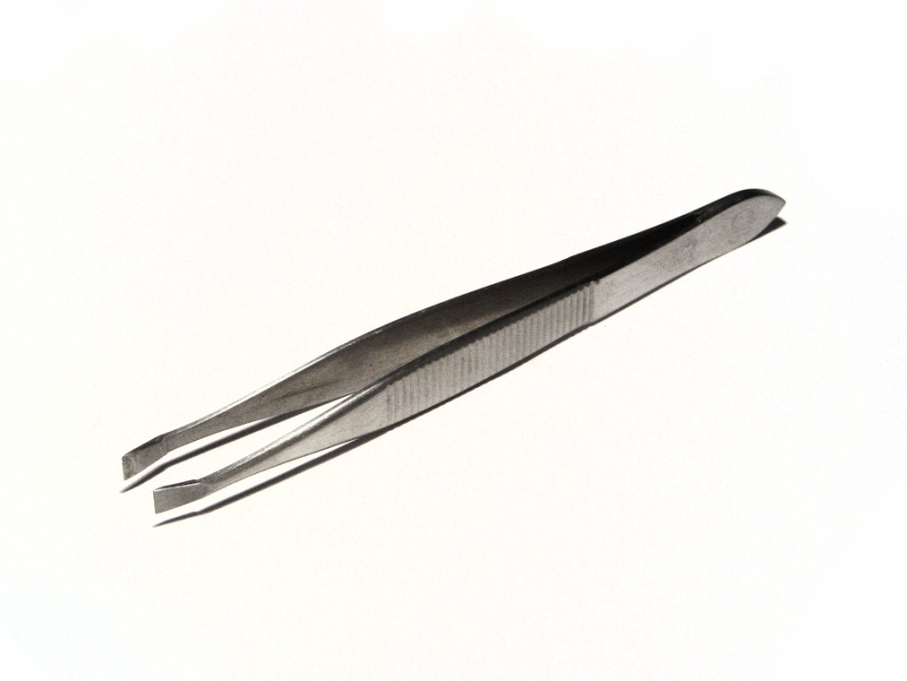
Concept Development
CFU 1
What does FOIL stand for?
Remembering lever classes
The three classes of lever can easily be remembered using the acronym FOIL.
Class 1: Fulcrum in the middle
Class 2: Output force in the middle
Class 3: Input force in the middle
Levers are easy to remember!
CFU 2
What class are each of these levers?

Slide 11
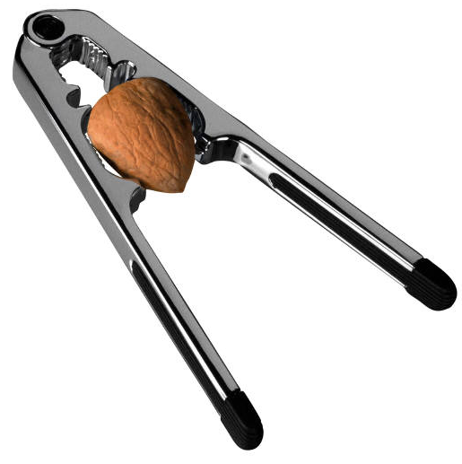
Skill Development / Guided Practice
Identifying Levers
Draw the lever on your whiteboard and label the fulcrum, input force and output force.
What class of lever is this? Explain your choice.
The nutcracker is a class ______ lever because the _______is positioned in the middle, between the ______ and the _______.
Reminder
FOIL! Class 1: Fulcrum in the middle Class 2: Output force in the middle Class 3: Input force in the middle Levers are easy!

Slide 12
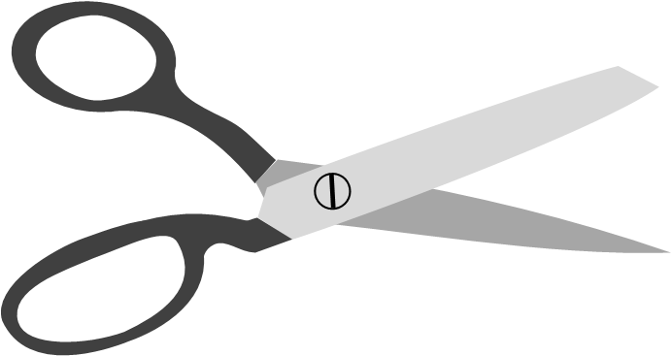
Skill Development / Guided Practice
Identifying Levers
Draw the lever on your whiteboard and label the fulcrum, input force and output force.
What class of lever is this? Explain your choice.
The scissors are a class ______ lever because the _______is positioned in the middle, between the ______ and the _______.
Reminder
FOIL! Class 1: Fulcrum in the middle Class 2: Output force in the middle Class 3: Input force in the middle Levers are easy!

Slide 13

Skill Development / Guided Practice
Identifying Levers
Draw the lever on your whiteboard and label the fulcrum, input force and output force.
What class of lever is this? Explain your choice.
The fishing rod is a class ______ lever because the _______is positioned in the middle, between the ______ and the _______.
Reminder
FOIL! Class 1: Fulcrum in the middle Class 2: Output force in the middle Class 3: Input force in the middle Levers are easy!

Slide 14
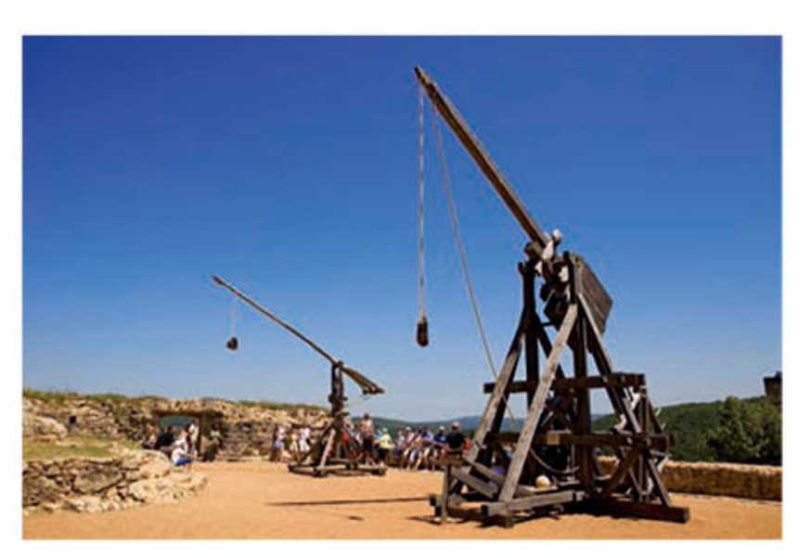

Relevance
As you’ve already seen, levers are literally everywhere.
Knowing how to use levers can make your life much easier!
Levers are used in construction, engineering, sports, and many other fields.

Slide 15
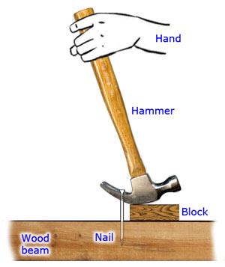
Skill Closure
1. Using your whiteboard and working with the person next to you, write down as many examples of levers as you can in 30 seconds.
2. A lever has the input force in the middle. What class of lever is it?
3. What class of lever is this lever below? Explain your choice.
Reminder
FOIL! Class 1: Fulcrum in the middle Class 2: Output force in the middle Class 3: Input force in the middle Levers are easy!

Slide 16
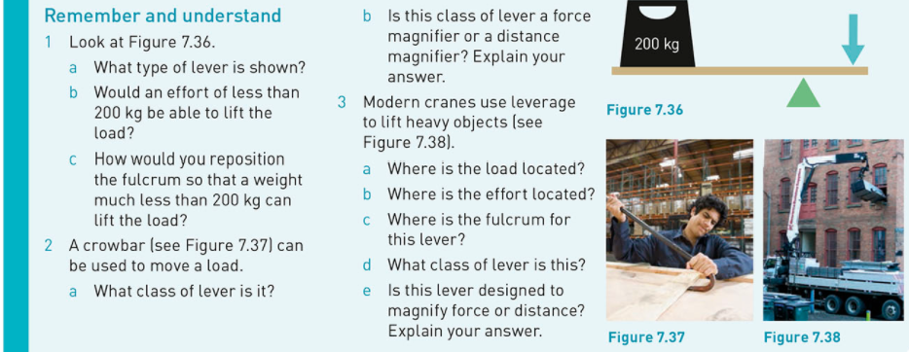
Independent Practice
1. Attempt Questions 1-3 on p. 133.
Skip 2b and 3e for now.

